Slide 1
Getting Lots of Data and Artificial Data

Slide 2
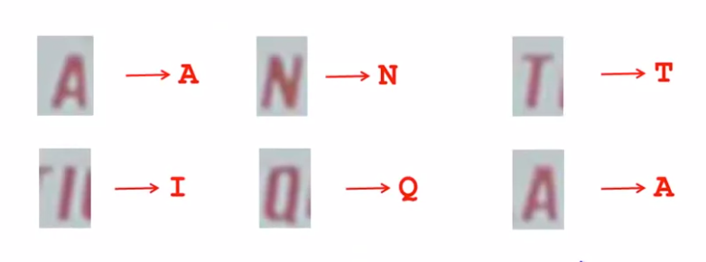
Character Recognition

Slide 3
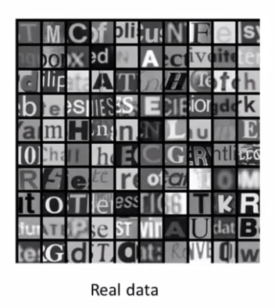
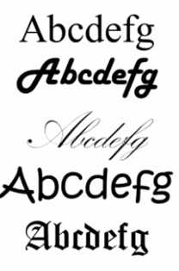
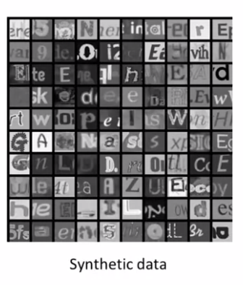
Artificial data synthesis for OCR
Computer Fonts

Slide 4
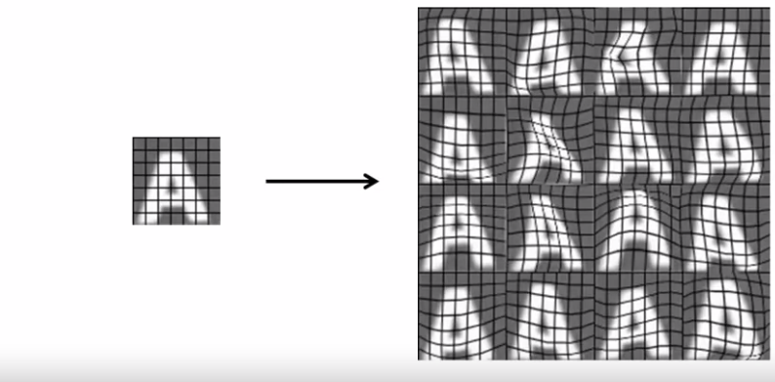
Synthesizing data by introducing distortions

Slide 5
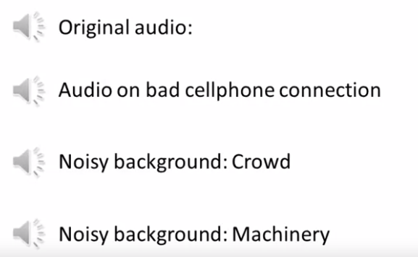
Synthesizing data by introducing distortions

Slide 6
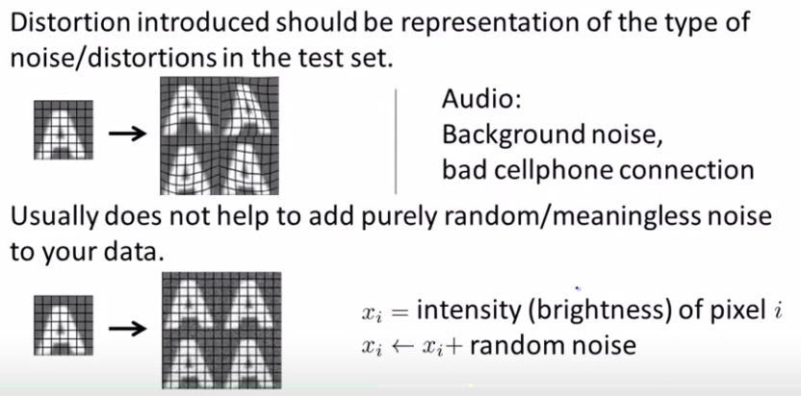
Synthesizing data by introducing distortions

Slide 7
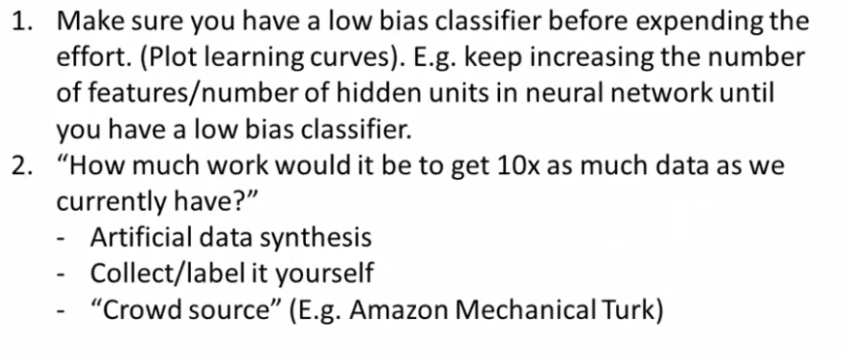
Discussion on getting more data

